Slide 1




Master Technical Document -katzbot
Jatin Kayasth
Student (AI)
Lakshmikar Reddy Polamreddy Student (AI)
Ruslan Gokhman Student (AI)
Thota Manish Kumar
Student (AI)
Atreish Ramlakhan Faculty

Slide 2
Table of contents
Introduction to Chabot
Introduction to RASA
RASA modules
How to install Rasa
nlu.yml
stories.yml
domain.yml
actions.py
RASA training
Adding Data for training

Slide 3
Running the API
Github
- Creating a Sub-branch
- Saving Changes in Your Sub-branch
- Pulling Changes from the Main Branch
- Pushing Changes to Remote Repository
ChatGPT introduction
ChatGPT api
Why use ChatGPT to create question-answers
Cost

Slide 4
NLP Preprocessing
Preprocessing – Segmentation
Preprocessing - Tokenization
Preprocessing - Stop-Words Removal
Preprocessing – Stemming
RNN (Recurrent neural networks)
LSTM models
Sequence-to-Sequence Models
Drawbacks of Encoder-Decoder Models
RASA Model
Why use DIET
Bag of words

Slide 5
Text cleaning techniques
N-gram approach
TF-IDF
Limitations of Bag-of-Words
Concept of Hyperparameter tuning
SCRIPT1_WEBSRAPING
SCRIPT2_EXTRACT_PDF
SCRIPT3_TEXT2ANSWERS_QUESTIONS
SCRIPT4_ENTITY_EXTRACTION
SCRIPT5_MULTIPLE_EXAMPLES
SCRIPT6_NLU_YML_FILE
SCRIPT7_STORIES_DOMAIN_YML_FILES
Challenges

Slide 6
Introduction to Chabot
A Chabot is an intelligent system used to simulate human-like behavior in conversations by interacting with users.
Chatbots utilize various techniques such as machine learning, natural language understanding, and context modeling to generate responses that mimic human conversation.
Chatbots can be found in various platforms, such as websites, messaging apps, social media platforms, and virtual assistants.
They serve a wide range of purposes, from providing customer support and answering frequently asked questions to assisting with tasks like scheduling appointments, making reservations, and more.

Slide 7
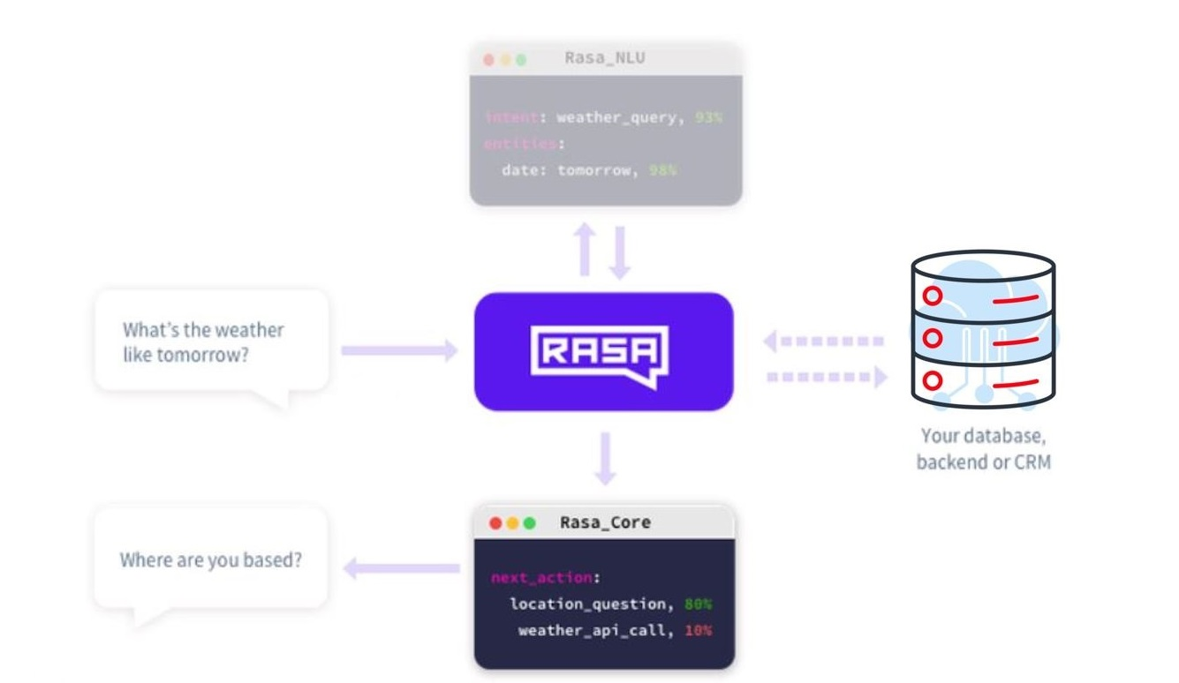
Introduction to RASA
Rasa is an open source machine learning framework for building AI assistants and chatbots.
It provides a set of tools and libraries that allow developers to create sophisticated and context-aware chatbots capable of handling natural language conversations.

Slide 8
RASA modules
Rasa has two main modules:
Rasa NLU
For understanding user messages
This is the place, where rasa tries to understand User messages to detect Intent and Entity in your message.
Rasa NLU is an open-source natural language processing tool for intent classification (decides what the user is asking), extraction of the entity from the bot in the form of structured data and helps the chatbot understand what user is saying.
Spacy (You need to install it separately), Tensorflow (By Default available with Rasa)

Slide 9
Rasa Core
For holding conversations and deciding what to do next
This is the place, where Rasa try to help you with contextual message flow. Based on User message, it can predict dialogue as a reply and can trigger Rasa Action Server.
This is the framework with machine learning-based dialogue management which takes the structured input from the NLU and predicts the next best action using a probabilistic model like LSTM neural network rather than if/else statement.
Rasa internally uses Tensorflow, whenever you do “pip install rasa” by default it installs Tensorflow.

Slide 10
How to install Rasa
It is highly recommended to use a virtual environment before installing RASA. For creating the virtual environment, the command in anaconda is:
conda create -n rasa python=3.9
activate rasa
To install the Rasa in the environment, we will install using pip install,
pip install rasa
Now, we will initialize the bot using rasa init. This will create the stating project files for the chatbot and train the initial model.
- rasa init

Slide 11
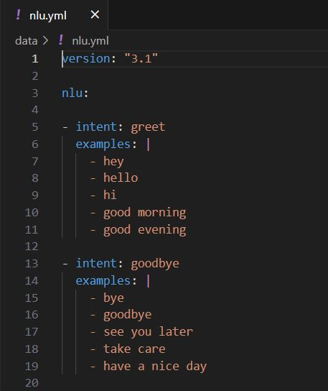
nlu.yml
In this file, we define our intents (what the user could ask the bot to do? ). These intents are then used in training the NLU model.
NLU training data consists of example user utterances categorized by intent.
Training examples can also include entities. Entities are structured pieces of information that can be extracted from a user's message
You can also add extra information such as regular expressions and lookup tables to your training data.

Slide 12
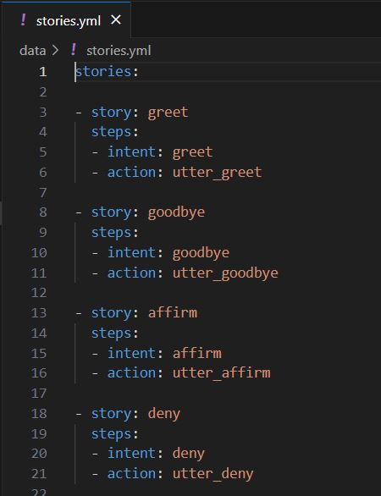
stories.yml
Stories are the sample conversation between a user and bot in the form of intents, responses and actions.
Rasa stories are a form of training data used to train the Rasa’s dialogue management models.
It is important to include the entities here as well because the policies learn to predict the next action based on a combination of both the intent and entities.

Slide 13
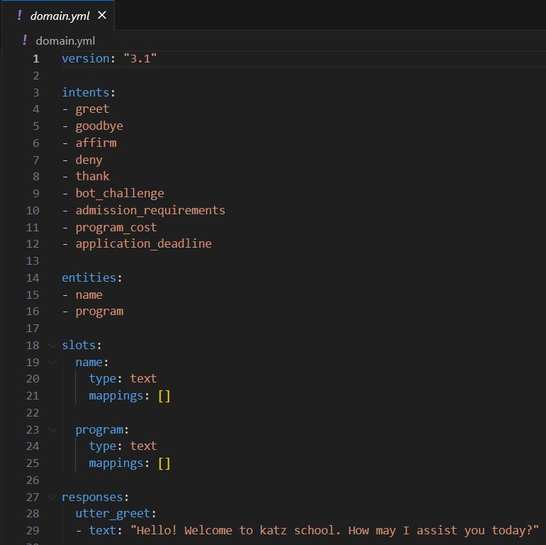
domain.yml
The domain defines the universe in which your assistant operates.
It specifies the intents, entities, slots, responses, forms, and actions your bot should know about. It also defines a configuration for conversation sessions.
The domain can be defined as a single YAML file or split across multiple files in a directory. When split across multiple files, the domain contents will be read and automatically merged together.
Using the command line interface, you can train a model with split domain files by running:
- rasa train –domain path_to_domain_directory

Slide 14
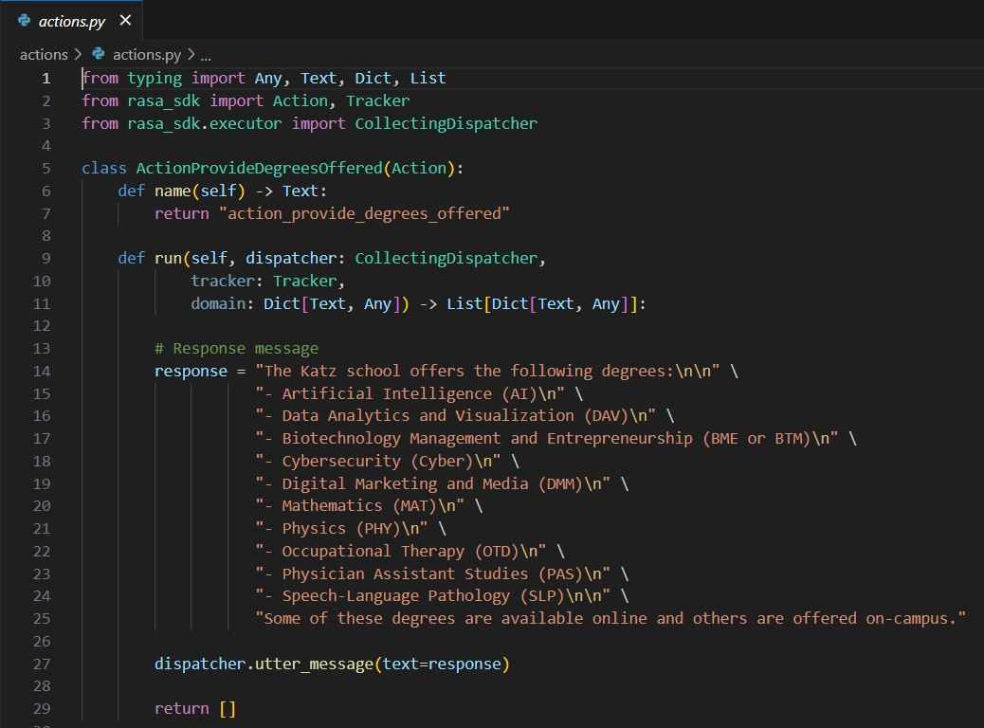
actions.py
This file is used for creating custom actions. In case you want to call an external server or fetch external API data, you can define your actions here.

Slide 15
RASA training
To train your Rasa model, follow these steps:
Create and structure your training data by adding .md or .yml files in the data directory.
Train the model using the following command:
- rasa train
Rasa will process your training data and train the model. The trained model will be saved in the models directory.

Slide 16
Adding Data for training
To add more training data to your Rasa model, follow these steps:
Open the relevant .md or .yml file in the data directory.
Add your training examples, intents, entities, and responses in the specified format.
Save the file.
Train the model again to incorporate the newly added data.

Slide 17
Running the API
To run the Rasa API and interact with your trained model, follow these steps:
Start the Rasa server using the following command:
rasa run -m models --enable-api --cors "*"
The API server will start, and you will see the endpoint information in the console.
You can now make HTTP requests to the API to send messages and receive responses from your trained Rasa model.

Slide 18
Github
GitHub is a platform and cloud-based service for software development and version control using Git, allowing developers to store and manage their code.
GitHub is a code hosting platform for version control and collaboration.
It makes it easy for developers to share code files and collaborate with fellow developers on open-source projects.

Slide 19
Github - Creating a Sub-branch
To create a subbranch for your work, use the following commands:
git checkout -b your-subbranch-name
This will create a new branch based on the current branch you are on.

Slide 20
Github - Saving Changes in Your Sub-branch
After making changes to your code, save the changes in your subbranch using the following commands:
git add .
git commit -m "Your commit message“
This will stage and commit your changes to your subbranch.

Slide 21
Github - Pulling Changes from the Main Branch
Before pushing your changes, it's a good practice to pull the latest changes from the main branch. Use the following command:
git pull origin main
This will fetch and merge the latest changes from the main branch into your current branch.

Slide 22
Github - Pushing Changes to Remote Repository
Once you are ready to push your changes to the remote repository, use the following command:
git push origin your-subbranch-name
This will push your changes to the remote repository, making them available for review and collaboration.

Slide 23
ChatGPT introduction
ChatGPT (Generative Pre-trained Transformer ) is an AI language model developed by OpenAI designed to process and generate human-like text based on the input it receives.
Model training involves exposure to an extensive range of texts from the internet, books, articles, and various other sources.
This enables the model to understand context, grammar, and language patterns, which allows it to engage in conversations, answer questions, provide explanations, generate creative writing, and much more.
More information available at https://platform.openai.com/docs/guides/gpt

Slide 24
ChatGPT api
ChatGPT API, allows developers to integrate ChatGPT into their own applications, products, or services.
The API allows you to interact with the ChatGPT model programmatically, enabling real-time conversations and obtaining responses dynamically.
To use the ChatGPT API, you need to make HTTP requests to OpenAI's API endpoint, sending a list of messages as input and receiving a model-generated message as output.
Each message in the list has two properties: 'role' (which can be 'system', 'user', or 'assistant') and 'content' (which contains the text of the message).

Slide 25
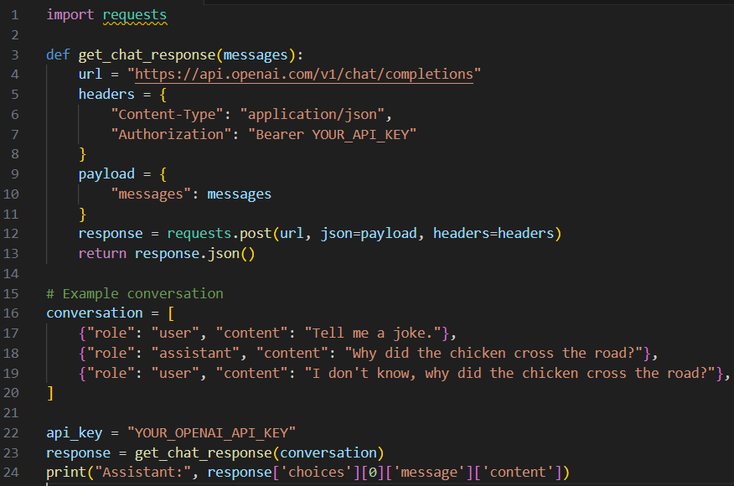
Here's a basic example of how you might use the API with Python and the popular ‘requests’ library:
You'll need to replace "YOUR_API_KEY" with your actual OpenAI API key, which you can obtain by signing up for access to the API on the OpenAI website.

Slide 26
Why use ChatGPT to create question-answers
Using ChatGPT for creating chatbot data can offer several benefits that contribute to the quality, diversity, and efficiency of your chatbot training dataset. Here are some advantages:
Contextual Understanding:
ChatGPT can generate responses that show an understanding of context, which is valuable for training your chatbot to maintain coherent and relevant conversations.
Reduced Annotation Effort:
Creating training data can be time-consuming. ChatGPT can assist in generating initial training data, which can then be fine-tuned and curated by human reviewers.

Slide 27
Large-Scale Data Generation:
ChatGPT can quickly generate a large volume of conversational data, providing ample examples for training your chatbot, even in scenarios with limited human-generated data.
Fast Iteration:
Generating content with ChatGPT allows you to rapidly iterate and experiment with different conversation flows, responses, and user interactions during the chatbot's development.

Slide 28
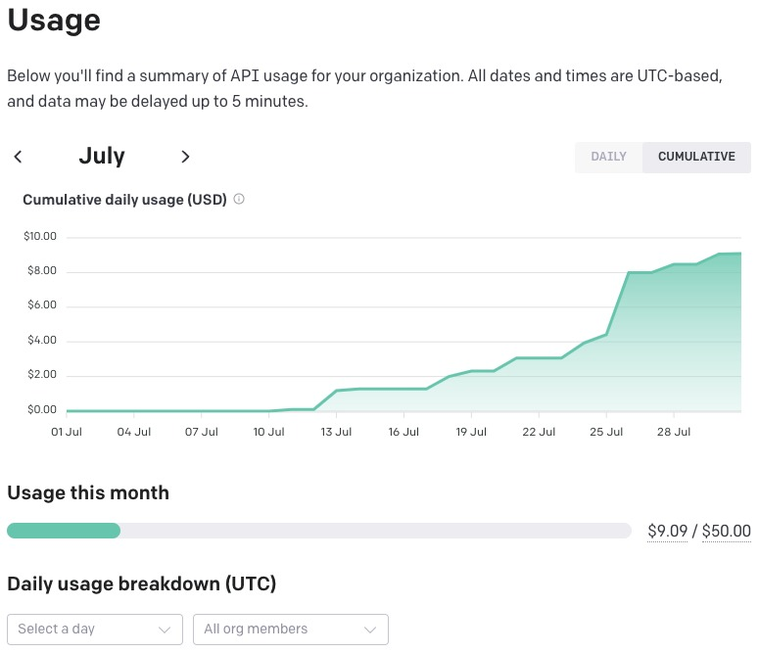
Cost
The total cost incurred for using ChatGPT for creating the training data for Katz school which included webpages, pdf files and data from users, was less than a total of 10$.

Slide 29
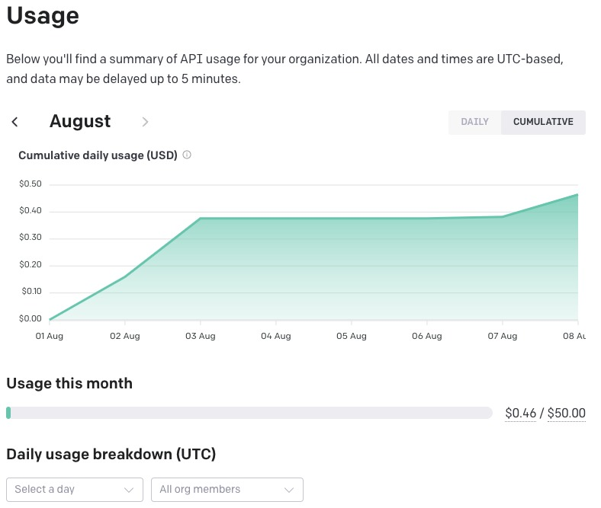

Slide 30
NLP Preprocessing
A natural language processing system for textual data reads, processes, analyzes, and interprets text. As a first step, the system preprocesses the text into a more structured format using several different stages.
An NLP pipeline for document classification might include steps such as sentence segmentation, word tokenization, lowercasing, stemming or lemmatization, stop word removal, and spelling correction.
Some or all of these commonly used text preprocessing stages are used in typical NLP systems, although the order can vary depending on the application.

Slide 31
Preprocessing - Segmentation
Segmentation involves breaking up text into corresponding sentences.
While this may seem like a trivial task, it has a few challenges.
For example, in the English language, a period normally indicates the end of a sentence, but many abbreviations, including “Inc.,” “Calif.,” “Mr.,” and “Ms.,” and all fractional numbers contain periods and introduce uncertainty unless the end-of-sentence rules accommodate those exceptions.

Slide 32
Preprocessing - Tokenization
The tokenization stage involves converting a sentence into a stream of words, also called “tokens.” Tokens are the basic building blocks upon which analysis and other methods are built.
Word Tokenization - It splits a piece of text into individual words based on a certain delimiter.One of the major issues with word tokens is dealing with Out Of Vocabulary (OOV) words. OOV words refer to the new words which are encountered at testing. These new words do not exist in the vocabulary. Hence, these methods fail in handling OOV words.
Character Tokenization – It splits apiece of text into a set of characters and handles OOV words coherently by preserving the information of the word, but the length of the input and output sentences increases rapidly as we are representing a sentence as a sequence of characters.

Slide 33
Subword Tokenization – It splits the piece of text into subwords (or n-gram characters). For example, words like lower can be segmented as low-er, smartest as smart-est, and so on.
Byte Pair Encoding (BPE) - is a widely used tokenization method among transformer-based models. BPE addresses the issues of Word and Character Tokenizers:
BPE tackles OOV effectively. It segments OOV as subwords and represents the word in terms of these subwords
The length of input and output sentences after BPE are shorter compared to character tokenization. BPE is a word segmentation algorithm that merges the most frequently occurring character or character sequences iteratively.

Slide 34
Preprocessing - Stop-Words Removal
"Stop words" are frequently occurring words used to construct sentences. In the English language, stop words include is, the, are, of, in, and and.
For some NLP applications, such as document categorization, sentiment analysis, and spam filtering, these words are redundant, and so are removed at the preprocessing stage.

Slide 35
Preprocessing - Stemming
The term word stem is borrowed from linguistics and used to refer to the base or root form of a word. For example, learn is a base word for its variants such as learn, learns, learning, and learned.
Stemming is the process of converting all words to their base form, or stem. Normally, a lookup table is used to find the word and its corresponding stem.
There are different techniques available for stemming namely “Porter Stemmer” or “Snowball stemmer” or “Lancaster stemmer”.
The Porter stemmer is the most widely used algorithm, and it is based on a set of heuristics that are used to remove common suffixes from words.

Slide 36
RNN (Recurrent neural networks)
Recurrent neural networks are different from traditional feed-forward neural networks.
Recurrent neural networks contain cycles that feed the network activations from a previous time step as inputs to the network to influence predictions at the current time step.
These activations are stored in the internal states of the network which can in principle hold long-term temporal contextual information.
This mechanism allows RNNs to exploit a dynamically changing contextual window over the input sequence history.

Slide 37
3 basic requirements of a recurrent neural network:
That the system be able to store information for an arbitrary duration.
That the system be resistant to noise (i.e. fluctuations of the inputs that are random or irrelevant to predicting a correct output).
That the system parameters be trainable (in reasonable time).
Unfortunately, the range of contextual information that standard RNNs can access is in practice quite limited.

Slide 38
LSTM models
Long Short-Term Memory (LSTM) networks are a type of recurrent neural network capable of learning order dependence in sequence prediction problems.
The problem is that the influence of a given input on the hidden layer, and therefore on the network output, either decays or blows up exponentially as it cycles around the network’s recurrent connections.
This shortcoming is referred to in the literature as the “Vanishing gradient problem”.
Long Short-Term Memory (LSTM) is an RNN architecture specifically designed to address the vanishing gradient problem.

Slide 39
An LSTM layer consists of a set of recurrently connected blocks, known as memory blocks.
These blocks can be thought of as a differentiable version of the memory chips in a digital computer.
Each one contains one or more recurrently connected memory cells and three multiplicative units – the input, output and forget gates – that provide continuous analogues of write, read and reset operations for the cells.
The net can only interact with the cells via the gates.
Learning rate and network size are the most crucial tunable LSTM hyperparameters.

Slide 40
Since LSTMs are effective at capturing long-term temporal dependencies without suffering from the optimization hurdles that plague simple recurrent networks (SRNs), they have been used to advance the state of the art for many difficult problems.
This includes handwriting recognition and generation, language modeling and translation, acoustic modeling of speech, speech synthesis, protein secondary structure prediction, analysis of audio, and video data among others.

Slide 41
Sequence-to-Sequence Models
Sequence to Sequence models, also known as seq2seq models, are a unique type of recurrent neural network architectures that we frequently utilize to address complicated language challenges, such as machine translation, question answering, chatbot creation, text summarization, etc.
This model can be used as a solution to any sequence-based problem, especially ones where the inputs and outputs have different sizes and categories.

Slide 42
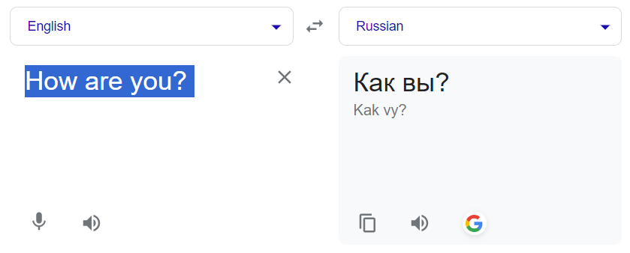
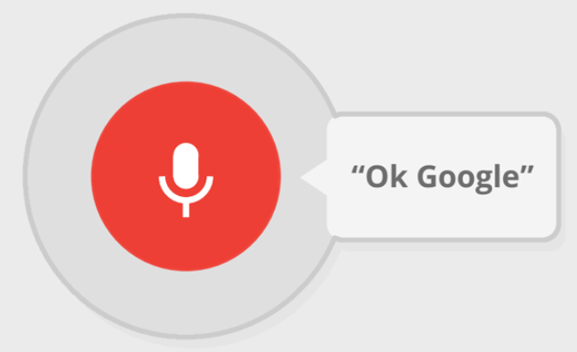
Use Cases of the Sequence to Sequence Models:
Machine translation
Speech recognition

Slide 43
There are two components for a Seq-2-Seq model, which are
Encoder
decoder
Both encoder and the decoder are LSTM models (or sometimes GRU models).
Encoder reads the input sequence and summarizes the information in something called the internal state vectors or context vector (in case of LSTM these are called the hidden state and cell state vectors).We only keep the internal states after discarding the encoder's outputs. In order to aid the decoder in making precise predictions, this context vector seeks to include the data for all input elements.

Slide 44
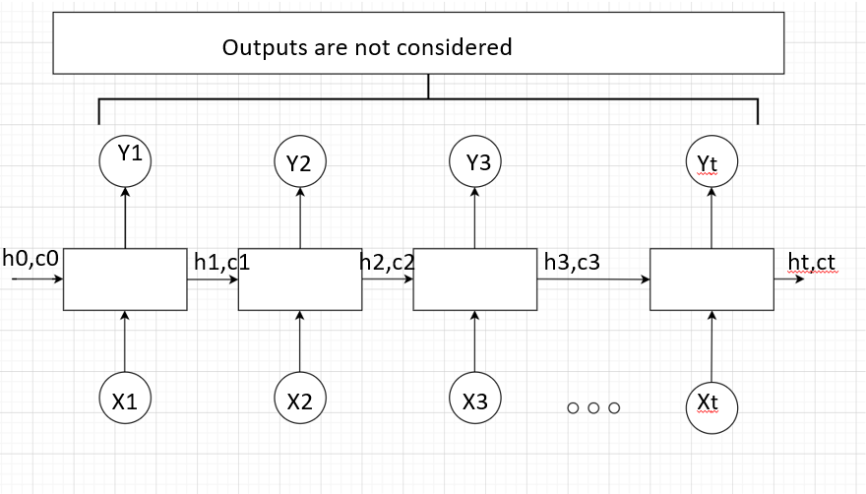
The LSTM reads the data, one sequence after the other. Thus if the input is a sequence of length ‘t’, we say that LSTM reads it in ‘t’ time steps.
Xi = Input sequence at time step i.
hi and ci = LSTM maintains two states (‘h’ for hidden state and ‘c’ for cell state) at each time step. Combined together these are internal state of the LSTM at time step i.
Yi = Output sequence at time step i. Yi is actually a probability distribution over the entire vocabulary which is generated by using a softmax activation. Thus each Yi is a vector of size “vocab_size” representing a probability distribution.

Slide 45
The decoder is an LSTM whose initial states are initialized to the final states of the Encoder LSTM, i.e. the context vector of the encoder’s final cell is input to the first cell of the decoder network. Using these initial states, the decoder starts generating the output sequence, and these outputs are also taken into consideration for future outputs.
A stack of several LSTM units where each predicts an output y_t at a time step t.
Each recurrent unit accepts a hidden state from the previous unit and produces and output as well as its own hidden state.
We calculate the outputs using the hidden state at the current time step together with the respective weight W(S). Softmax is used to create a probability vector which will help us determine the final output (e.g. word in the question-answering problem).

Slide 46
Drawbacks of Encoder-Decoder Models
There are two primary drawbacks to this architecture, both related to length.
Firstly, as with humans, this architecture has very limited memory. That final hidden state of the LSTM, which we call S or W, is where you’re trying to cram the entirety of the sentence you have to translate.S or W is usually only a few hundred units (read: floating-point numbers) long — the more you try to force into this fixed dimensionality vector, the lossier the neural network is forced to be.
The deeper a neural network is, the harder it is to train.

Slide 47
RASA Model
New state-of-the-art lightweight, multitask transformer architecture for NLU: Dual Intent and Entity Transformer (DIET).
DIET is a multi-task transformer architecture that handles both intent classification and entity recognition together.
It provides the ability to plug and play various pre-trained embeddings like BERT, GloVe, ConveRT, and so on.
There isn't a single set of embeddings that is consistently best across different datasets. A modular architecture, therefore, is especially important for these tasks.

Slide 48
Why use DIET
Large-scale pre-trained language models have shown promising results on language understanding benchmarks like GLUE and SuperGLUE, and in particular, shown considerable improvements over other pre-training methods like GloVe and supervised approaches.
BERT and other big language models achieve top performance on a variety of NLP tasks. While it helps resolve some issues, BERT also presents its own challenges; really slow and needs a GPU to train.
Large-scale models tend to be compute-intensive, training time-intensive.
Also, if you're building multilingual AI assistants, it's important to achieve high level performance without large-scale pre-training as most pre-trained models are trained on English text.

Slide 49
DIET is different because it:
Is a modular architecture that fits into a typical software development workflow
Parallels large-scale pre-trained language models in accuracy and performance
Improves upon current state of the art and is 6X faster to train

Slide 50
Bag of words
Prior to DIET, Rasa's NLU pipeline used a bag of words model where there was one feature vector per user message.
Machine learning algorithms cannot work with raw text directly; the text must be converted into numbers. Specifically, vectors of numbers. “In language processing, the vectors x are derived from textual data, in order to reflect various linguistic properties of the text.” This is called feature extraction or feature encoding.
A bag-of-words model, or BoW for short, is a way of extracting features from text for use in modeling, such as with machine learning algorithms.

Slide 51
Example, for this sample text
“It was the best of times, it was the worst of times, it was the age of wisdom, it was the age of foolishness”
The unique words here (ignoring case and punctuation) are:
“it”, “was”, “the”, “best”, “of”, “times”, “worst”, “age”, “wisdom”, “foolishness”.
That is a vocabulary of 10 words from a corpus containing 24 words.
Documents would look as follows:
“It was the best of times” = [1, 1, 1, 1, 1, 1, 0, 0, 0, 0]
“it was the worst of times” = [1, 1, 1, 0, 1, 1, 1, 0, 0, 0]
“it was the age of wisdom” = [1, 1, 1, 0, 1, 0, 0, 1, 1, 0]
“it was the age of foolishness” = [1, 1, 1, 0, 1, 0, 0, 1, 0, 1]

Slide 52
Text cleaning techniques
There are simple text cleaning techniques that can be used as a first step, such as:
Ignoring case
Ignoring punctuation
Ignoring frequent words that don’t contain much information, called stop words, like “a,” “of,” etc.
Fixing misspelled words.
Reducing words to their stem (e.g. “play” from “playing”) using Stemming(Porter or Snowball)/Lemmatization algorithms.

Slide 53
N-gram approach
A more sophisticated approach is to create a vocabulary of grouped words. This both changes the scope of the vocabulary and allows the bag-of-words to capture a little bit more meaning from the document.
For example, the bigrams in the first line of text in the previous section: “It was the best of times” are as follows:
“it was”, “was the”, “the best”, “best of”, “of times”.

Slide 54
TF-IDF
A problem with scoring word frequency is that highly frequent words start to dominate in the document (e.g. larger score), but may not contain as much “informational content” to the model as rarer but perhaps domain specific words.
This approach to scoring is called Term Frequency – Inverse Document Frequency, or TF-IDF for short, where:
Term Frequency: is a scoring of the frequency of the word in the current document.
Inverse Document Frequency: is a scoring of how rare the word is across documents.
The scores are a weighting where not all words are equally as important or interesting.

Slide 55
Limitations of Bag-of-Words
Vocabulary: The vocabulary requires careful design, most specifically in order to manage the size, which impacts the sparsity of the document representations.
Sparsity: Sparse representations are harder to model both for computational reasons (space and time complexity) and also for information reasons, where the challenge is for the models to harness so little information in such a large representational space.
Meaning: Discarding word order ignores the context, and in turn meaning of words in the document (semantics). Context and meaning can offer a lot to the model, that if modeled could tell the difference between the same words differently arranged (“this is interesting” vs “is this interesting”), synonyms (“old bike” vs “used bike”), and much more.

Slide 56
DIET uses a sequence model that takes word order into account, thereby offering better performance.
It's also a more compact model with a plug-and-play, modular architecture. For instance, you can use DIET to do both intent classification and entity extraction.
You can also perform a single task, for example, configure it to turn off intent classification and train it just for entity extraction.
DIET is not only considerably faster to train but also parallels large-scale pre-trained language models in performance.
It outperforms fine-tuning BERT and improves upon the current state of the art on a complex NLU dataset.

Slide 57
Concept of Hyperparameter tuning
Hyperparameter tuning is a crucial process in machine learning, including NLP (Natural Language Processing), where it involves finding the optimal set of hyperparameters for a given model to achieve the best performance on a specific task.
Hyperparameters are parameters that are set before the training process begins and cannot be learned directly from the data. They control various aspects of the training process and model architecture.
In the context of NLP models, hyperparameters can significantly impact a model's effectiveness in understanding and generating human language.

Slide 58
When it comes to selecting the hyperparameters for tuning purposes, these are parameters like learning rate, batch size, number of layers, hidden units, dropout rate, regularization strength, optimizer type, sequence length, and more.
There are several strategies to explore the hyperparameter space, such as:
Grid Search: Exhaustively search through all combinations of hyperparameters in the defined search space.
Random Search: Randomly sample combinations of hyperparameters from the search space. This can be more efficient than grid search.
Bayesian Optimization: Utilize probabilistic models to estimate the performance of different hyperparameter settings and select new points to evaluate based on the model's predictions.

Slide 59
Appropriate evaluation metric to measure the performance of NLP model is a must. This could be accuracy, F1-score, perplexity, BLEU score (for language generation tasks), etc. The choice of metric depends on the specific NLP task.
Hyperparameter tuning requires a balance between exploration and exploitation. It involves trade-offs between computational resources, time, and achieving better model performance.
Automated hyperparameter tuning libraries like Hyperopt, Optuna, and GridSearchCV (in scikit-learn) can assist in streamlining this process.

Slide 60
SCRIPT1_WEBSRAPING
We are scraping the webpages for each of the programs and faculty pages for the data.
For webscraping, we have used python scripts using library "Beautifulsoup" and "request" and written code to extract the information that we need from the pages. We have used regex functions to get the data in the format that we need to feed to chat-gpt to get the questions and answers data to be fed to the .yml file in RASA-Core.

Slide 61
Program data files contains:
Course description
Program Highlights
STEP-OPT eligible
Current Projects
Benefits
B.A./M.S. Pathways option
Internships
Faculty data files contains the information about each faculty in Katz school of science and health.

Slide 62
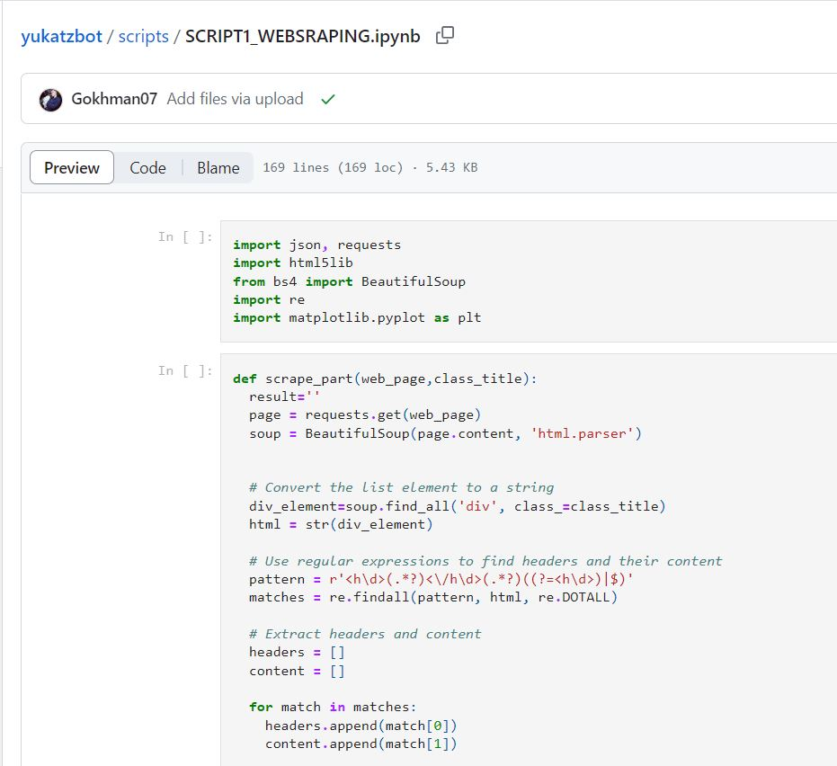
This file uses the function “scrape()” which takes link for the webpage and output filename as input and returns a text file containing all the information as mentioned above.
This function also used another function “scrape_part()” which takes web_page and class_title as input and return the part of the text from the webpages for each category.

Slide 63
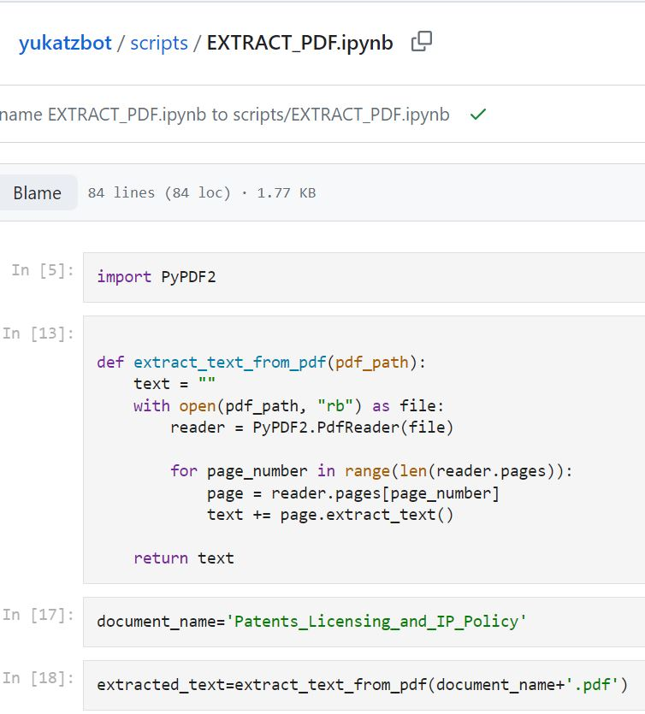
SCRIPT2_EXTRACT_PDF
This file is to extract data from pdf files using python library “PyPDF2” using the function extract_text_from_pdf().
This function takes path of the pdf file as input and returns all the pages from the file in text format.
Once the data is extracted, it is saved in a text file as output.

Slide 64
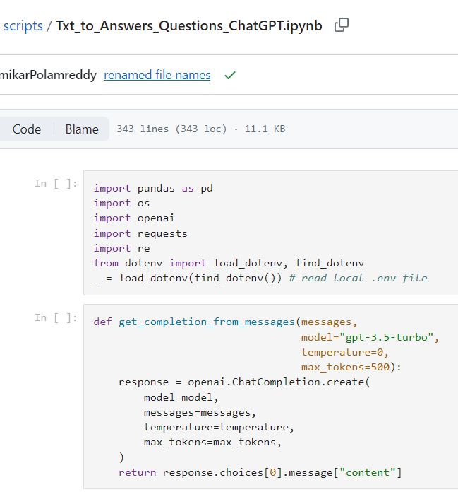
SCRIPT3_TEXT2ANSWERS_QUESTIONS
This file converts text files to Questions-Answers which are used to train the bot model.
Libraries used for this are pandas, os, openai, requests, re, dotenv.
The function get_completion_from_messages takes messages, model (default = “gpt-3.5-turbo”), temperature (default =0), and max_tokens (default =500) as input and returns questions and answers to those based on the messages.

Slide 65
temperature setting for ChatGPT allows for a balance between generating creative responses and maintaining a certain level of consistency and relevance.
Total tokens must be below the model’s maximum limit (4096 tokens for gpt-3.5-turbo).
Based on the files stored in the github repository, content of each file is read using the requests library and fed to the “get_completion_from_messages” as input with the prompt to get questions and answers to those questions based on the content of the file.
In case we do not get the response from the function error message is raised.
Once we have the questions and corresponding answer, we put in a dataframe, clean it and save it in a csv format for further use.

Slide 66
SCRIPT3_TEXT2ANSWERS_QUESTIONS_FACULTY and SCRIPT3_TEXT2ANSWERS_QUESTIONS_PROGRAMS scripts have the same function “get_completion_from_messages()” which takes model (default = “gpt-3.5-turbo”), temperature (default =0), and max_tokens (default =500) as input and returns questions and answers to those based on the messages.
The only difference in these scripts is the post processing done to clean the output question-answer that are generated from the ChatGPT model.

Slide 67
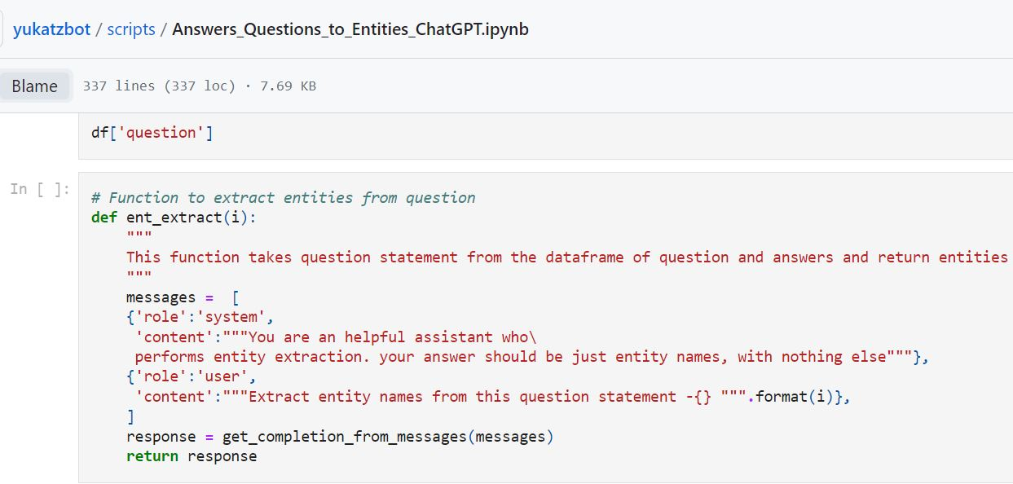
SCRIPT4_ENTITY_EXTRACTION
This file extracts entities from the question answers generated by ChatGPT using the function ent_extract().
This function takes the question statement, promts from the user and returns the entities associated with those questions using ChatGPT.
Once we have all the entities from all of the data, we save those to a text file.

Slide 68
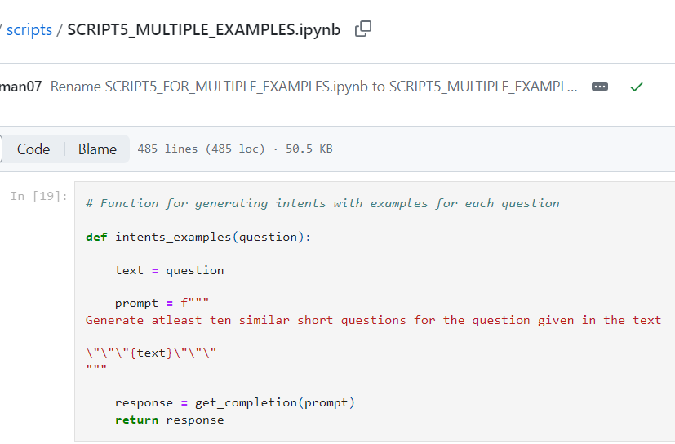
SCRIPT5_MULTIPLE_EXAMPLES
This script uses the function “intents_examples()” which uses promt from the user as “Generate atleast ten similar short questions for the question given in the text” and takes question from the master spreadsheet as input and generates similar question to the input.

Slide 69
This function internally uses “get_completion()” function takes messages, model (default = “gpt-3.5-turbo”), temperature (default =0), and max_tokens (default =500) as input and return the required text.
Once the additional questions are generated, it is saved to the existing master spreadsheet tho the same column as questions.

Slide 70
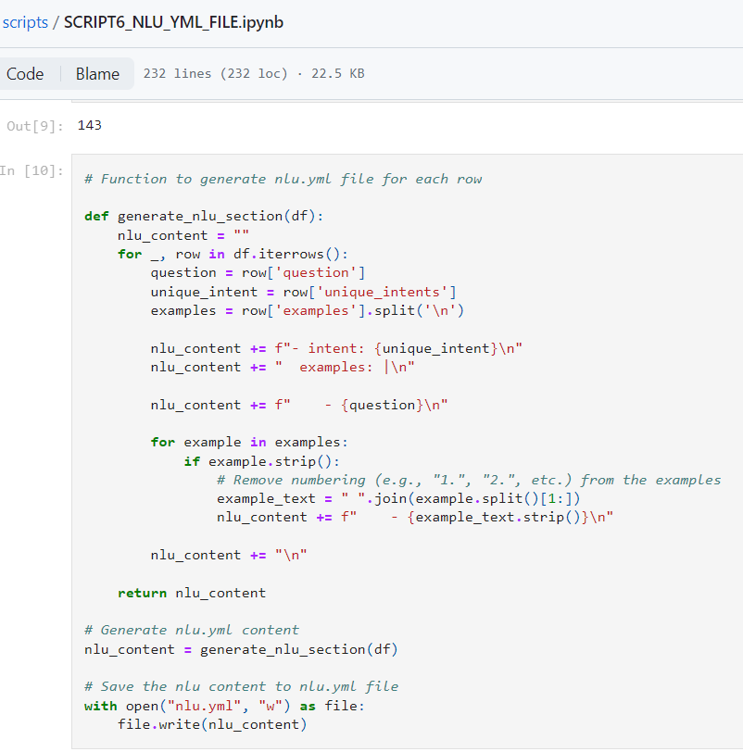
SCRIPT6_NLU_YML_FILE
This script uses “generate_nlu_section()” function which takes dataframe as input and return string of text as required for a nlu.yml file for RASA.
nlu.yml file looks like:

Slide 71
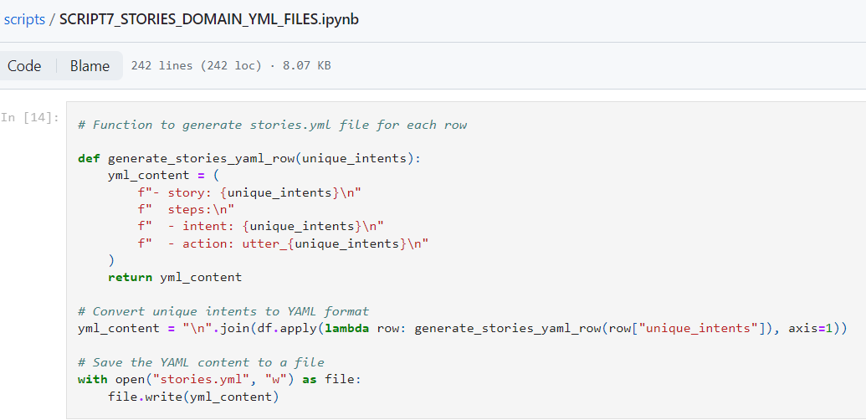
SCRIPT7_STORIES_DOMAIN_YML_FILES
This script uses “generate_stories_yaml_row()” function which takes unique intents as input and return string of text as required for stories.yml file for RASA.

Slide 72
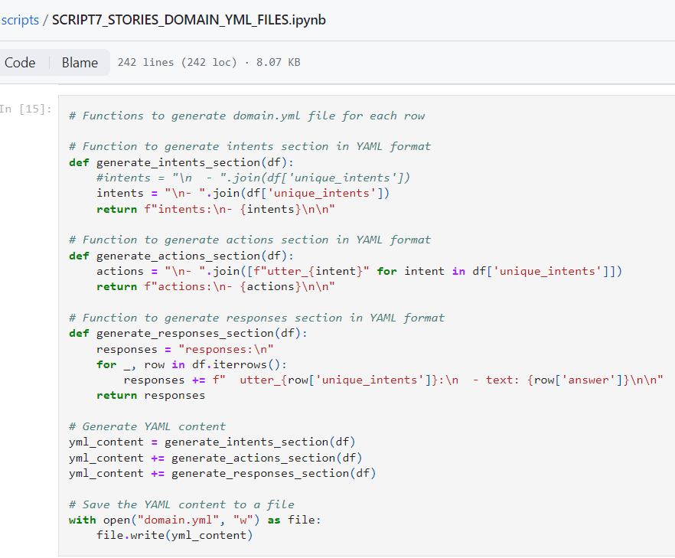
It also uses “generate_intents_section()”, generate_actions_section()” , generate_response_section()” function which takes dataframe as input and return intents, actions and responses and writes it to the domain.yml file.

Slide 73
Challenges
Developing different strategies for extracting questions and answers from various types of documents.
Generating strongly relevant questions to our field of studying.
Developing approach to get completely unique intent from questions.
Grouping questions strongly under one type of intent.
Organising prompts to generate big yml files.

